Slide 1
Web Services & REST API
Dr. Xueping Li

Slide 2
URLs
Web Dev Roadmap
https://www.w3schools.com/whatis/default.asp
HTML5 (w3schools)
CSS
JAVASCRIPT
BOOTSTRAP
W3.CSS
JQUERY
PHP

Slide 3
In Class Practice

Slide 4
In Class Practice

Slide 5
Set up a web server (software)
Prepare a simple index.html file first.
<!DOCTYPE html> <html> <head> <title>My Web</title> </head> <body> <h1>Welcome to IE421 Class! </h1> </body> </html>
Simply run this command (method #1)
php -S 127.0.0.1:8000
Note that port is 8000 which you can change.

Slide 6
Apache (#2)
> cd
> mkdir web
> cd web
> docker run -d -p 8000:80 --name my-apache-php-app -v "$PWD":/var/www/html php:7.2-apache

Slide 7
PHP SLIM (#3)
> REST API Server
>

Slide 8
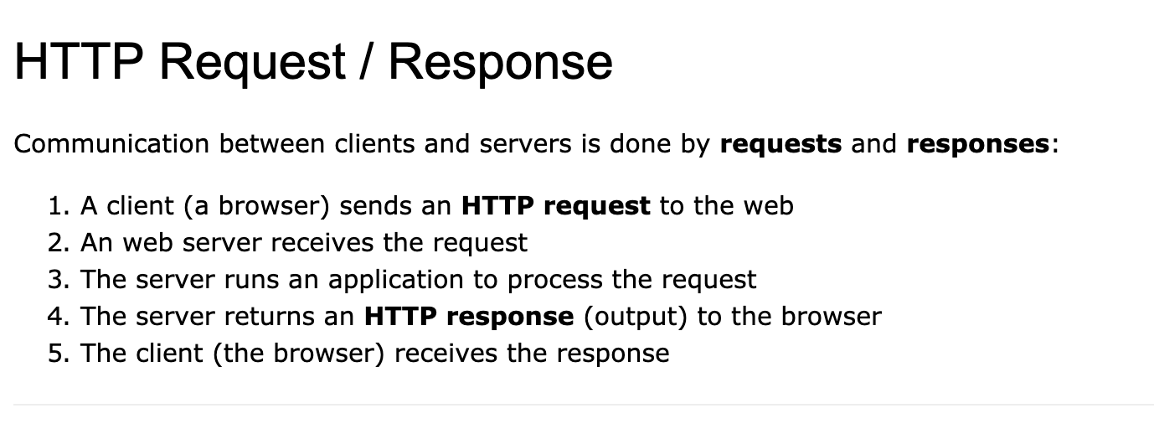
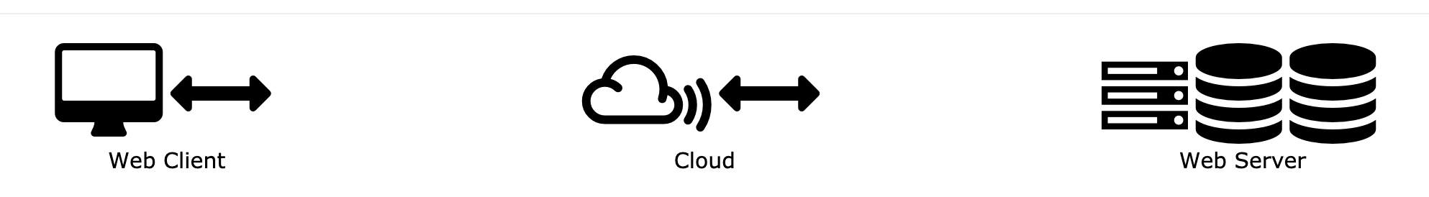
HTTP

Slide 9
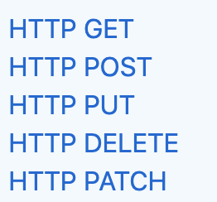
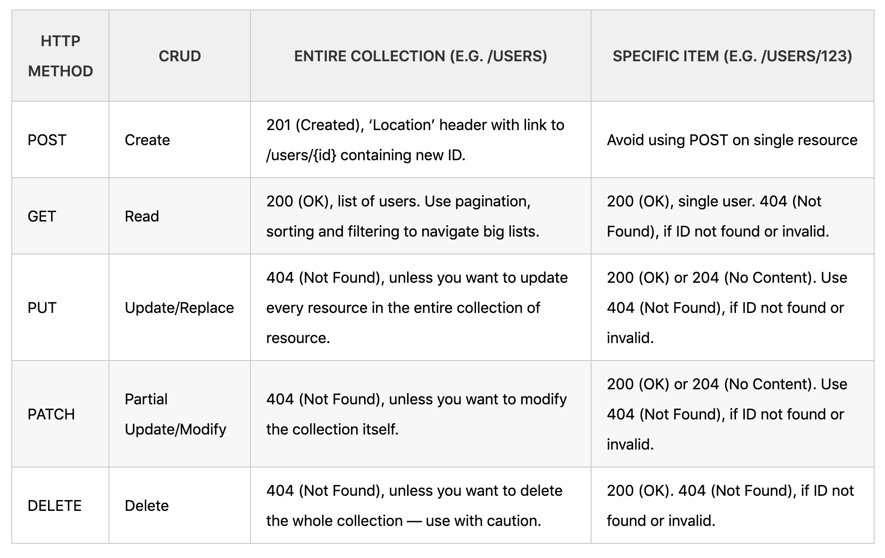
REST
https://spring.io/understanding/REST
REST (Representational State Transfer)

Slide 11
MAKE SURE TO RUN THIS FIRST:
ALTER USER ‘YOURUSR'@'%' IDENTIFIED WITH mysql_native_password BY ‘YOURPASSWORD';

Slide 12
A Contact Me form Example
Backend table creation
Front End Form
Backend web services
Link frontend to backend
Note all the source code is on the class Github repo under REST_API folder.

Slide 13
1. create a table (change to your own schema)
CREATE TABLE `rzhou7`.`contact` (
`create_time` TIMESTAMP NULL DEFAULT CURRENT_TIMESTAMP,
`update_time` TIMESTAMP NULL,
`id` INT NOT NULL AUTO_INCREMENT,
`name` VARCHAR(45) NOT NULL,
`email` VARCHAR(45) NOT NULL,
`subject` VARCHAR(45) NULL,
`message` VARCHAR(45) NULL,
PRIMARY KEY (`id`));

Slide 14
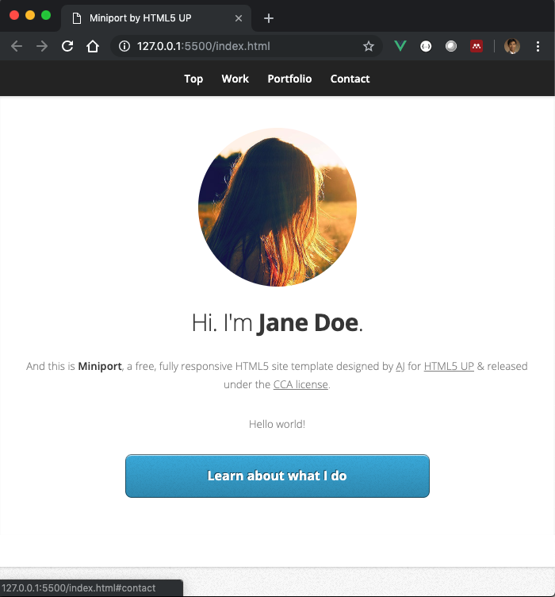
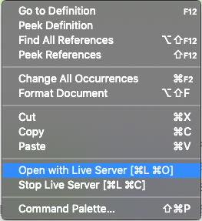
2. Front end
We simply used the Jane Doe template

Slide 15
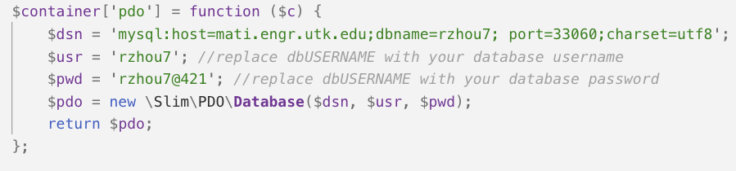
3. Backend Server & web services
Under the BACKEND sub folder.
Open using VS Code.
Update code in index.php
Add contact.php under the contact.php
GET
POST

Slide 16
Run this command to serve as a backend server:
php -S localhost:5500 index.php
Verify the service using Postman (Google it and install it) (Optional)

Slide 17
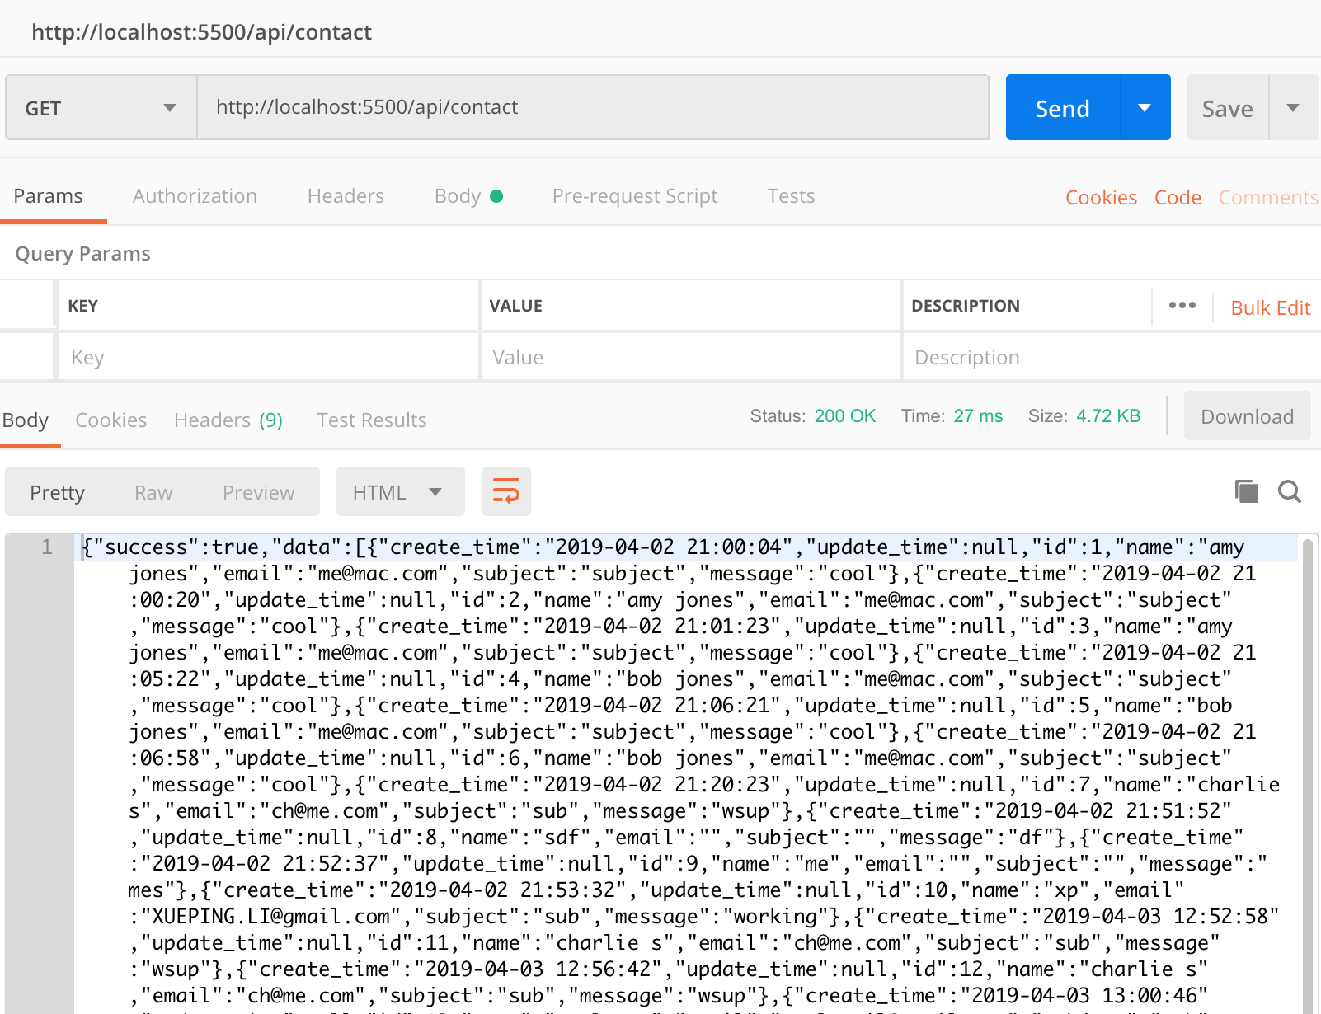
GET

Slide 18
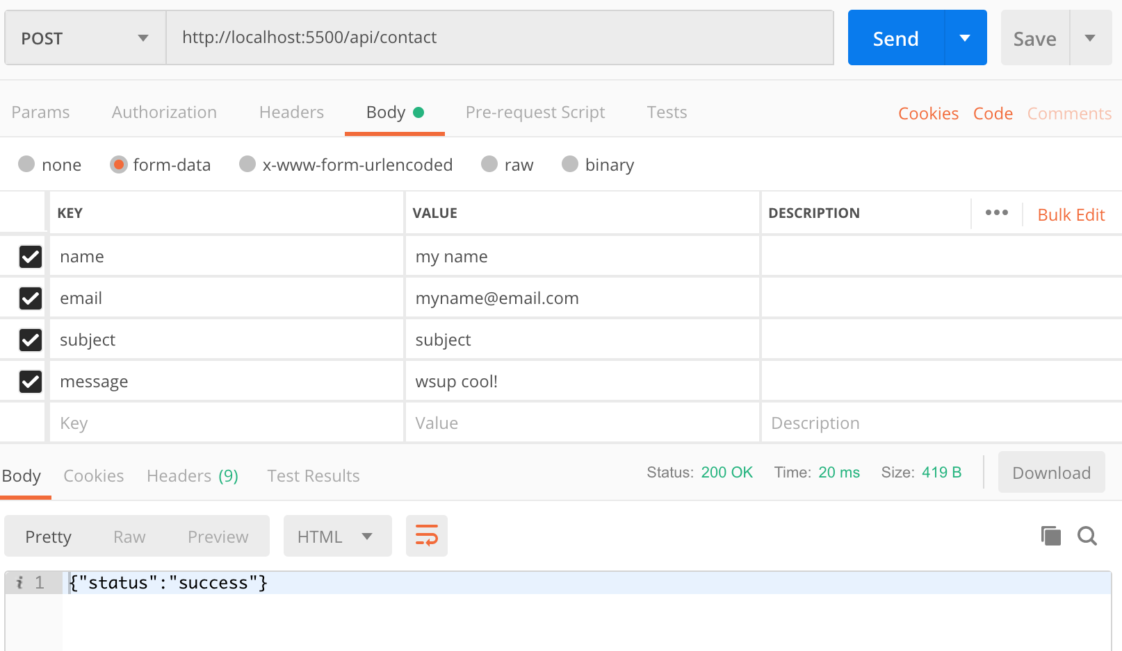
In POSTMAN
POST

Slide 19
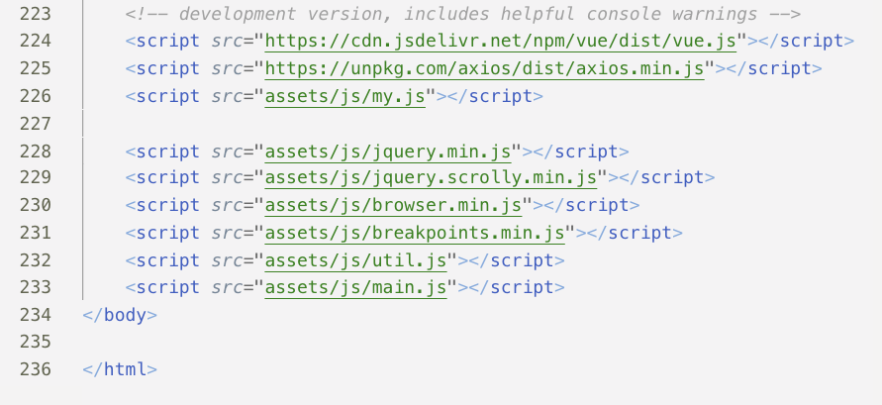
4. Link frontend to backend
Update index.html

Slide 20
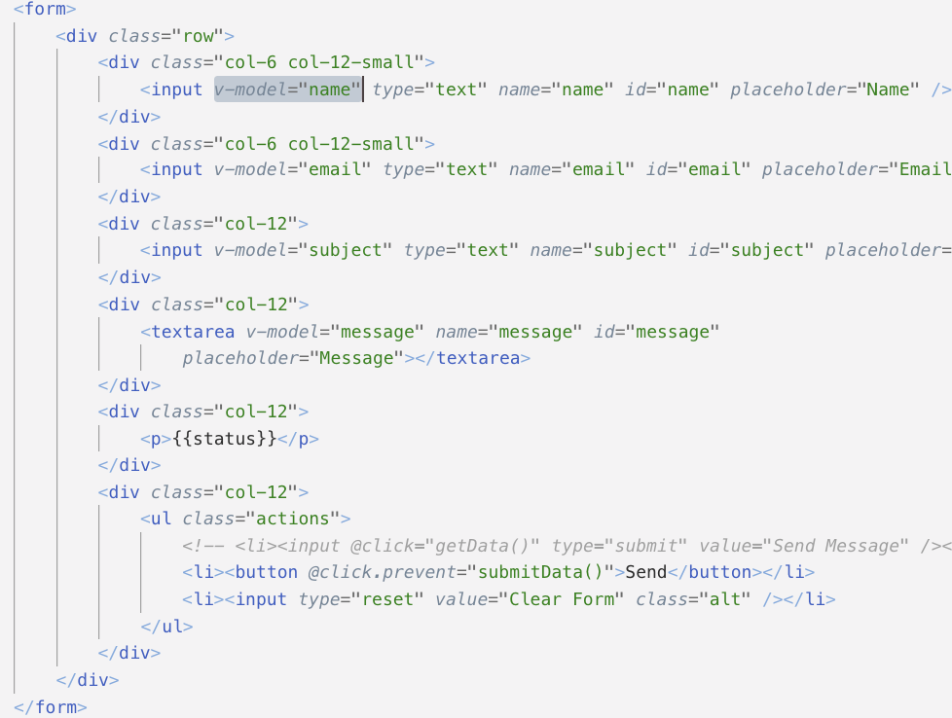

Slide 21
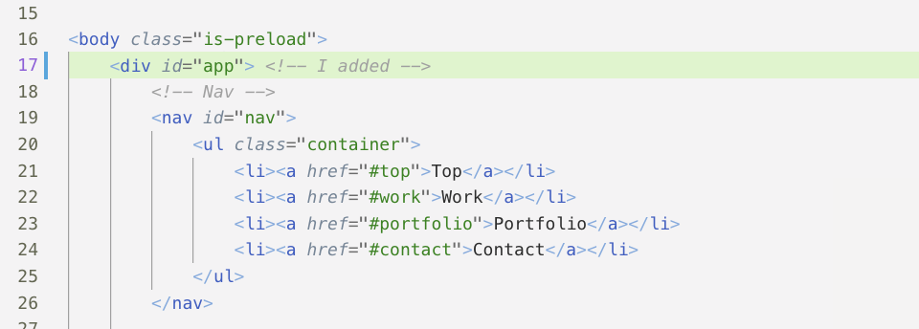

Slide 22
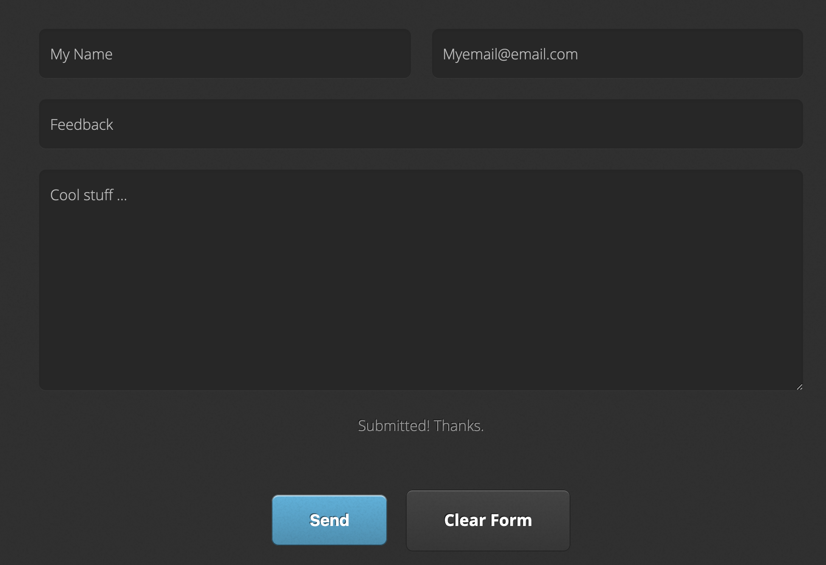
Create my.js under /assets/js
Test to see whether it works!

Slide 23
THAT’S IT!
We can do basic GET/POST REST API and do a full stack web from the front end to the back end.

